Slide 1


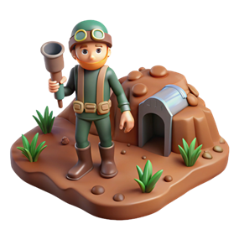

Underground Hero
Grouping according to requirements and design

Slide 2


Content
Problem and opportunity
Game idea
Prototype & Teamwork
Play Testing
Results and Next Step
Conclusion

Slide 3



Problem & Opportunity
Many students confuse requirements and design in real-world tasks
Lack of practical engagement in software engineering concepts (Sommerville, 2015 )
Opportunity: Make abstract RE concepts interactive, urgent, and memorable

Slide 4
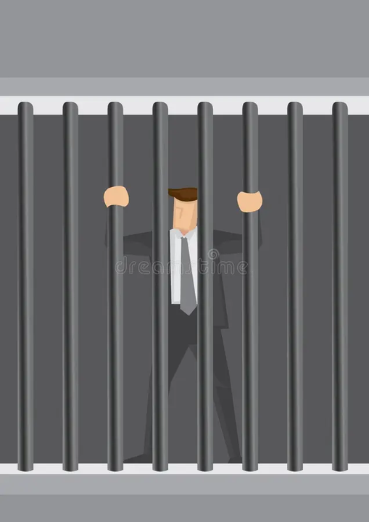
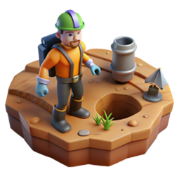
Game Idea
Can he rescue hostages?
Goal
Classify elements as Requirements or Design before time runs out.
Save hostages to progress, fail and retry.
Gamifies learning through urgency, repetition, and level progression

Slide 5

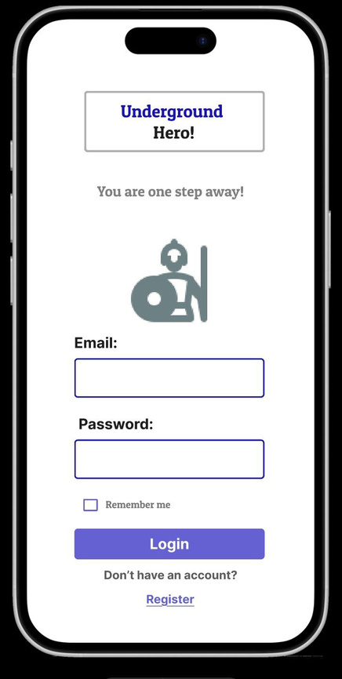
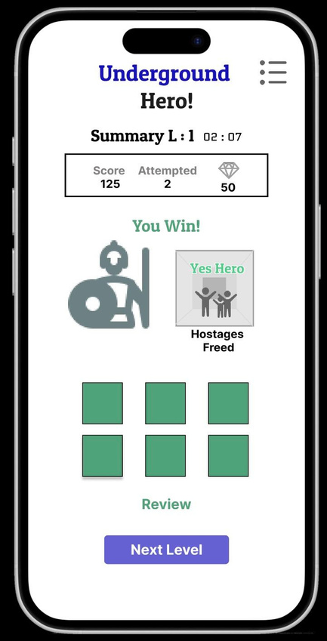
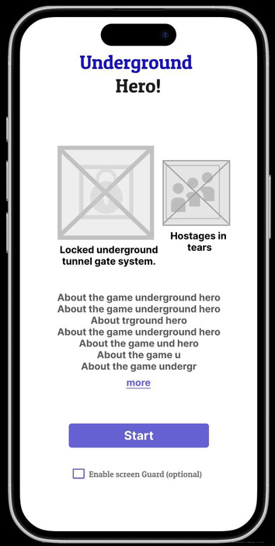
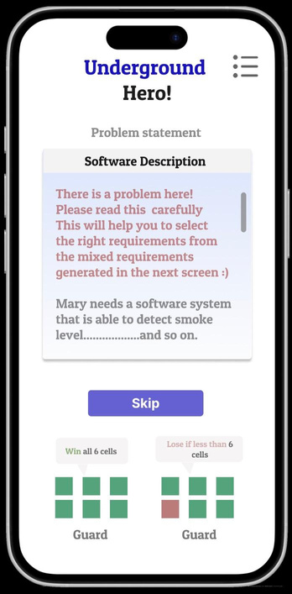
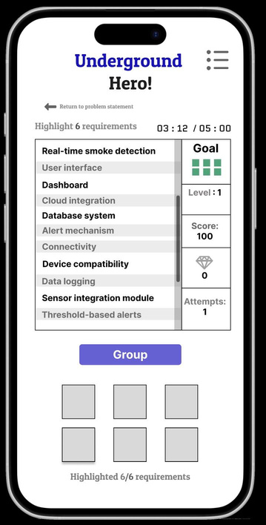
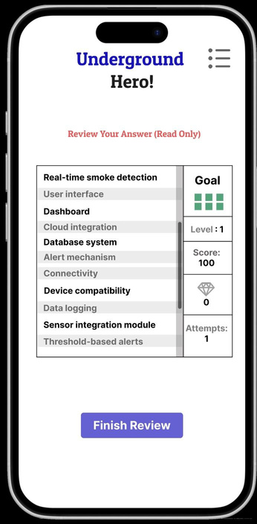
Prototype
Rapid prototyping using UML diagrams and Figma mockups
Game loop: Login ->Read->Classify -> Submit ->Rescue ->Next Level
Team of 7 students contributing in design, testing, and presentation

Slide 6


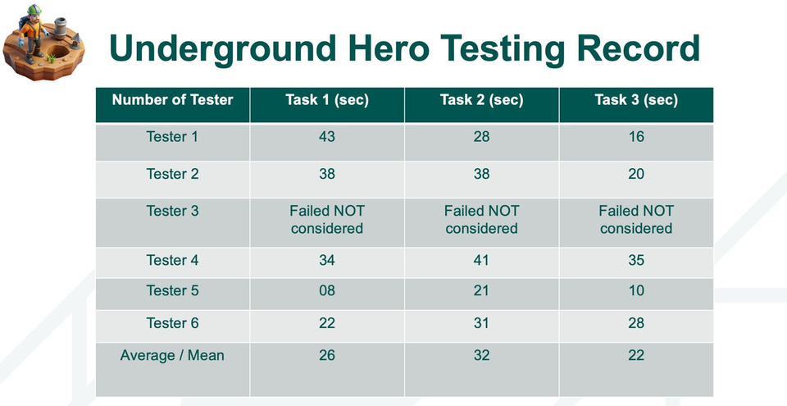
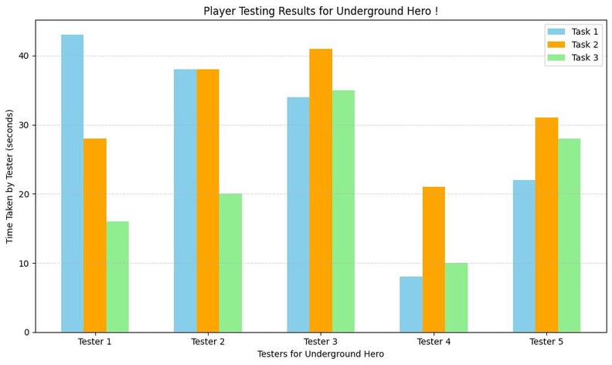
play testing
feedback on MECHANICS
Players immersed in the urgency of saving lives. Misclassifications add dramatic consequence. Gathered feedback on UI clarity, timing pressure, and enjoyment.
Players immersed in the urgency of saving lives
Misclassifications add dramatic consequence
Gathered feedback on UI clarity, timing pressure, and enjoyment
graph

Slide 7


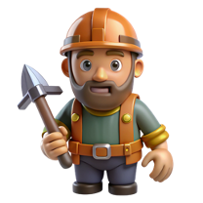
RESULTS AND NEXT STEPS
Higher concept retention among testers
Strong engagement due to narrative and time pressure
Next: Expand levels, audio cues, and multiplayer leaderboard

Slide 8
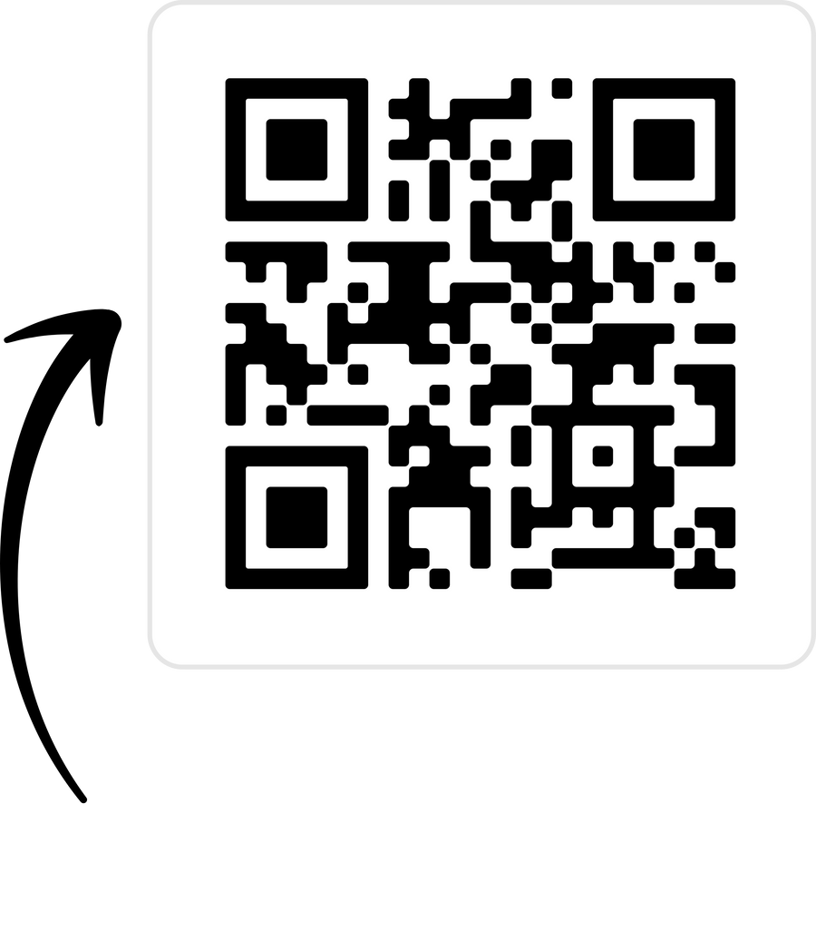
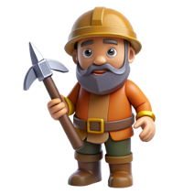
CONCLUSION
Underground Hero creates lasting learning moments
Realistic stress = stronger understanding
Shows game-based learning works for core software concepts
Scan here & be Hero!

Slide 9



Thank you!

